Slide 1
2026 Financial Plan
Projections Through 2031

Slide 2
Introduction
Data-Driven Decisions
Analyze Revenue and Expenditure Trends
Identify Impactful Circumstances
Project Resources and Needs
Maintain Structural Balance

Slide 3
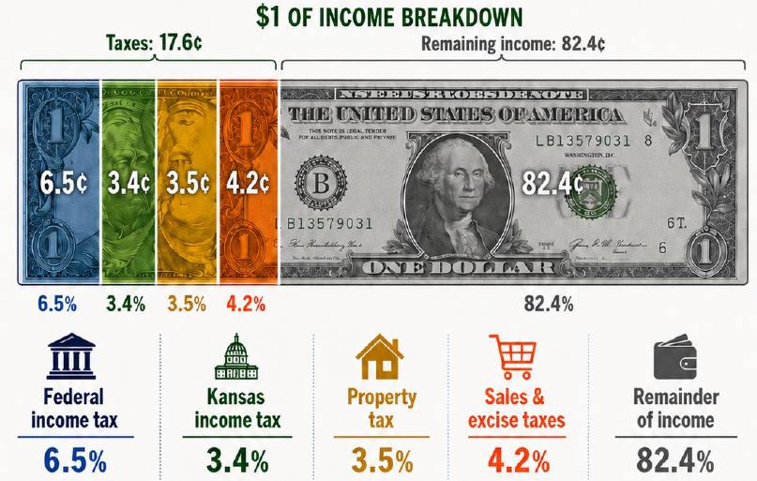
Taxes in Kansas
Source: League of Kansas Municipalities

Slide 4
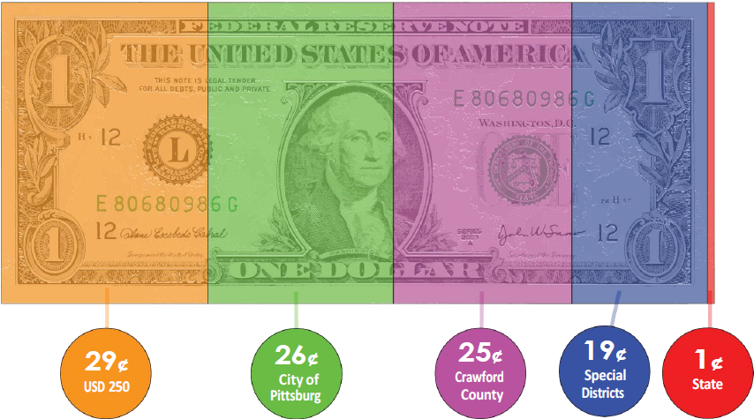
Your Property Tax Dollar
Source: League of Kansas Municipalities

Slide 5
Budget Assumptions and Actuals
 | 2025 Actual | 2026 Submitted Budget | 2026 Final Budget
Sales Tax | 5.6% | 2.5% | 2.5%
Assessed Value | 7.7% | 9.0% | 6.6%
Mill Rate | 50.854 | 50.854 | 52.006
Prop Tax Coll | 4.5% | 9.0% | 10.1%
Utility Rate | 3.0% | 3.0% | 3.0%
Franchise Tax | 4.5% | 0.0% | 0.0%
Other GMF | 7.5% | 0.0% | 0.0%
COLA | 3.0% | 2.0% | 3.0%
Budget is submitted to City Commission in July
Final determination of AV and mill rate is done by County in November

Slide 6
Fund Accounting and Fund Types
General Fund
  Primary Revenues: Property and Sales Taxes
  Primary Services: Police, Fire, Administration, Facility Maintenance, Parks & Recreation
Utility Funds
  Primary Revenues: Charges for Services
  Primary Services: Water, Sewer, Stormwater, Sanitation
Special Purpose (Restricted) Funds
  Primary Revenues: Dedicated Sales Tax, Intergovernmental, Charges for Services, Transfers
  Primary Services: Health Care, Capital Equipment, Memorial Auditorium, Golf Course, Airport, Aquatic Center

Slide 7
General Funds - Operations
General Fund
Public Safety Sales Tax
Health Care
Golf Course
Airport
Aquatic Center
Farmers’ Market
Characteristics:
Fundamental source of funding for local government operations
Primarily tax funded
Least restricted
Funds are created to track specific revenues and expenditures

Slide 8
Utility Funds
Water
Wastewater
Stormwater
Sanitation
Characteristics:
Established to run as a municipal business
Completely supported through charges and fees (not taxes)
Charges and fees should cover all costs
Revenues and expenditures are restricted to specific operations

Slide 9
Special Purpose/Restricted Funds
Sales Tax Capital Outlay
Memorial Auditorium
Special Drug/Alcohol
Library
Street Sales Tax
Section 8
Revolving Loan Fund
Debt Service
Special Parks & Recreation
Street and Highway Fund
Characteristics:
Funded from dedicated revenue source – taxes, charges for service, grants/donations
Pay-as-you-go, expenditures should match revenues
Expenditures are limited to specific purposes

Slide 10
General Fund by Operations
Property Tax Support

Slide 11
General Fund by Operations
Sales Tax Support
Total $12,781,661

Slide 12
Programs Funded by Both
Property and Sales Tax
Additional funding for each of the following services was approved by the voters in special elections. These were traditionally only funded by property tax.
Police
Fire
Street Preservation
Memorial Auditorium
Economic Development (also utility funds)
Capital Equipment (also utility and bond funds)
General Operations (County sales tax)

Slide 13
Actuals

Slide 14
Revenues
2025 General Fund Revenues by Source
Total
$19,977,210

Slide 15
Total Property Tax - 2026
Entity | Mill Rate
USD 250 | 55.717 | 35.0%
City of Pittsburg | 52.006 | 32.6%
Crawford County | 48.639 | 30.5%
State of Kansas | 1.500 | 0.9%
Kansas Wildcat Extension #14 | 1.456 | 0.9%
TOTAL | 159.318

Slide 16
Pittsburg Property Tax - 2026
Entity | Mill Rate
General Fund | 37.789
Debt Service | 8.083
Library | 6.134
TOTAL | 52.006
Impacting Factors:
Most stable revenue stream
County determines assessed value and assigns mill rate
Budgetary guidance provided in June, final calculation in October
Debt service and Library are restricted
Primary funding source for:
  Public Safety
  Workforce Retention
  Parks and Recreation
  Infrastructure

Slide 17
Property Tax Actuals
Assessed Value

Slide 18
Mill Rates, Valuation, Levy
Year | Mill Rate | Change | Assessed Value | Dollars Levied | Change
2026 | 52.006 | 2.3% | $179,626,310 | $9,342,043 | 9.0%
2025 | 50.854 | -0.1% | 168,488,334 | 8,574,203 | 5.2%
2024 | 50.889 | -1.9% | 160,191,141 | 8,153,088 | 10.3%
2023 | 51.896 | 0.5% | 143,208,170 | 7,394,698 | 6.6%
2022 | 51.636 | 0.3% | 134,771,598 | 6,937,369 | 0.8%
2021 | 51.475 | 0.0% | 134,528,473 | 6,879,544 | -1.2%
2020 | 51.469 | 0.0% | 135,225,048 | 6,959,910 | 3.5%
2019 | 51.493 | 0.1% | 130,553,454 | 6,722,521 | 1.9%
2018 | 51.467 | -0.1% | 128,182,295 | 6,597,188 | 6.7%
2017 | 51.539 | Avg. 0.1% | 119,976,319 | 6,183,482 | Avg. 4.8%

Slide 19
Sales Taxes
Pittsburg Sales Tax Earmarks
Purpose | Rate | End Date
Public Safety | .50 | 12-31-2033
Street Maintenance | .50 | 3-31-2031
Economic Development | .25 | Ongoing
Capital Outlay | .125 | Ongoing
Memorial Auditorium | .125 | Ongoing
Total | 1.50

Slide 20
Total Sales Tax Collections - Actuals
Impacting Factors:
State limit is 2%, city’s assessment is 1.5% (could assess an additional .5%)
Sales tax collections have increased an average of 6.4% annually
Sales tax is volatile – since 2018, increase has been from .7% to 13.7%
Sales taxes have been approved by voters to address needs not able to be met by property tax

Slide 21
Sales Tax in Pittsburg
Total
9.0%

Slide 22

Pittsburg Sales Taxes - 1.5%

Slide 23
Expenditure Categories - Examples
Personnel Services
  Salaries
  Health Care
  Taxes
  Retirement Contributions
Contractual Services
  Software Licenses
  Utilities
  Professional Services
  Maintenance
  Training
  Lease Payments
Commodities
  Operating Supplies (shop and office)
  Gas and Oil
  Chemicals
  Rock
  Asphalt
Capital Outlay
  Machinery (including IT)
  Equipment
  Vehicles

Slide 24
General Fund Expenditures by Category

Slide 25
Category Share of General Fund Expenditures

Slide 26
Water/Wastewater Fund Expenditures by Category

Slide 27
Projections
Primary Assumptions and Impacting Factors

Slide 28
Primary Assumptions - Revenues
Sales Tax: Historical – 6.4%, Projection – 2.5%
Property Tax: Historical – 5.6%, Projection 3%
Other Revenues
  Franchise: Historical – 0.9%, Projection – flat (one-time increase of $200,000 for data center)
  Gaming: Historical – 2.6%, Projection - flat
  Health Care: Historical 1.5%, Projection - 5%
  Investments: Historical Average
  Grants/Fines/Fees/Misc – Historical Average
  Utility revenues: Historical – 4%, Projection 3%

Slide 29
Property Tax Projections
Year | 2021 | 2022 | 2023 | 2024 | 2025 | 2026 | 2027 | 2028 | 2029 | 2030 | 2031
Amount | $5,574,017 | $5,655,741 | $5,869,032 | $6,416,327 | $6,619,728 | $7,500,538 | $7,642,522 | $7,814,584 | $7,990,948 | $8,171,721 | $8,357,014

Slide 30
Sales Tax Projections
2021 | 2022 | 2023 | 2024 | 2025 | 2026 | 2027 | 2028 | 2029 | 2030 | 2031
9,928,821 | 11,288,628 | 12,010,126 | 12,098,666 | 12,781,661 | 12,526,900 | 12,799,532 | 13,078,168 | 13,362,944 | 13,653,996 | 13,951,463

Slide 31
Projections by Fund – General
Impacting Factors:
Property tax collections increase 3%, 3%, 3%, 2%, 2%
Sales tax increase 2.5% annually
Salary increase annually – 2%, 3%, 2%, 3%, 2%
Increase in Revenues from Data Center - $320,000 annually
50% increase in cost of gas - $100,000 each year
Ongoing contribution to Kelce School from gaming revenue - $400,000
Structurally balanced until 2031

Slide 32
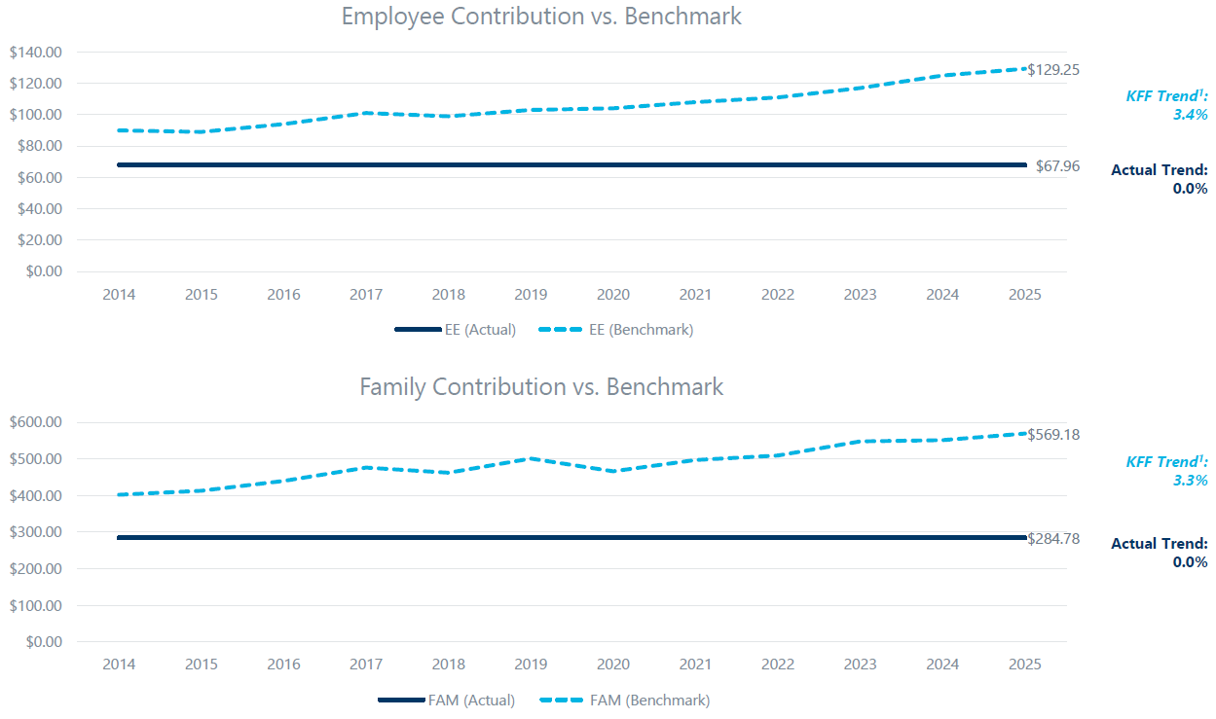
Health Care Contribution v. Benchmark
Source: IMA

Slide 33
2025 Bond Debt - $13,565,310

Slide 34
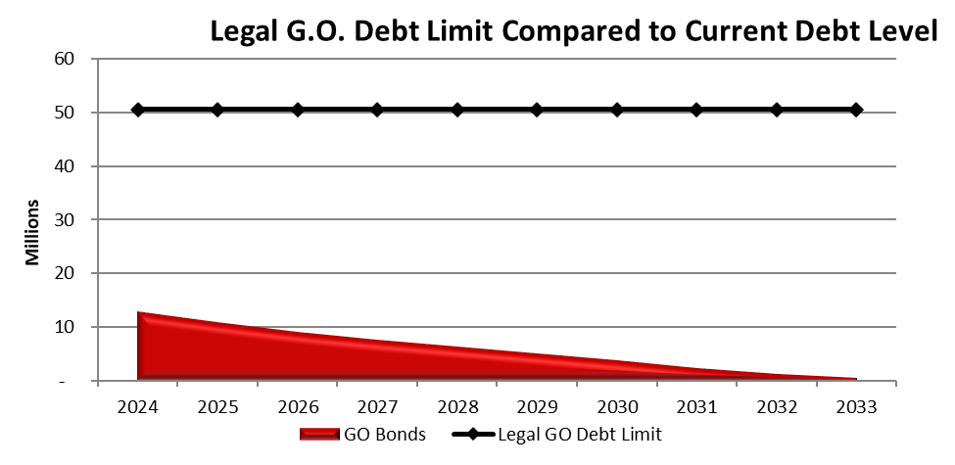
Debt Service – GO Bond Limits

Slide 35
General Fund Reserves

Slide 36
Summary
Priorities are public safety and infrastructure
Revenues highly dependent on property and sales tax
Conservative revenue estimates
Anticipating increasing costs
Risks are volatility of sales tax and inflation impact
Projections are for steady growth and structural financial balance

