Slide 1
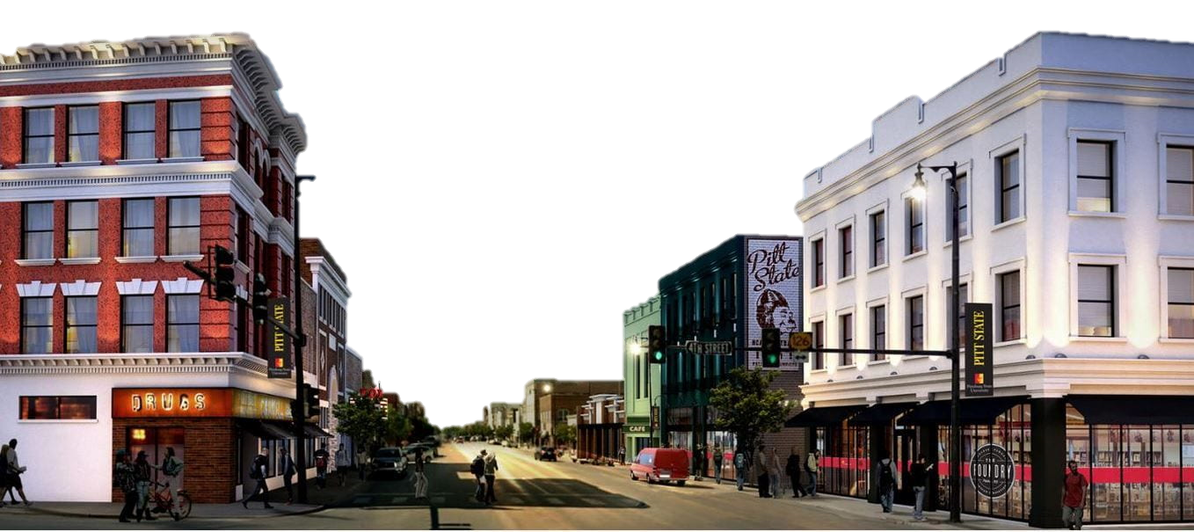
Economic Performance
Dr. Michael Davidsson
Associate Professor Director, Business and Economic Research Center

Slide 2
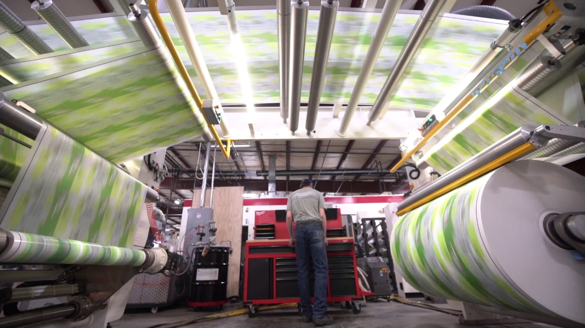
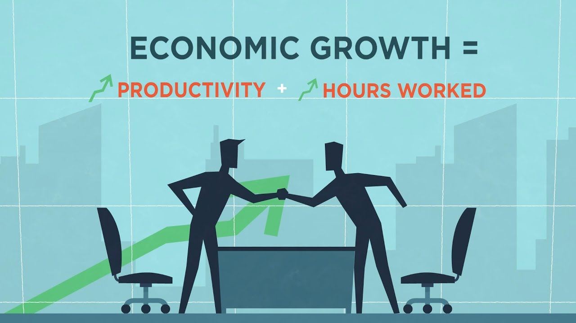
Jobs and Productivity

Slide 3

Source: Quarterly Census of Employment

Slide 4
Number of Businesses by Employee Size
Pittsburg Micropolitan Area Q4’2021
Quarter | Size class | Establishments | Percent of Total Establishments | Percent of Total firms accumulated | Percent of total employment accumulated
Q4 2021 | 0 | 101 | 10.2% | 10.2% | 0.9%
Q4 2021 | 1 - 4 | 398 | 40.1% | 50.3% | 5.7%
Q4 2021 | 5 - 9 | 207 | 20.8% | 71.1% | 13.7%
Q4 2021 | 10 - 19 | 132 | 13.3% | 84.4% | 24.4%
Q4 2021 | 20 - 49 | 102 | 10.3% | 94.7% | 42.7%
Q4 2021 | 50 - 99 | 27 | 2.7% | 97.4% | 53.0%
Q4 2021 | 100 - 249 | 13 | 1.3% | 98.7% | 64.3%
Q4 2021 | 250 - 499 | 8 | 0.8% | 99.5% | 79.9%
Q4 2021 | 500 - 999 | 4 | 0.4% | 99.9% | 94.3%
Q4 2021 | 1000 + | 1 | 0.1% | 100.0% | 100.0%
Source: Kansas Labor Market Information

Slide 5
Source: Quarterly Census of Employment & Wages

Slide 6
Unfilled Local Jobs
624 job openings advertised
Major employers looking
CDL Electric Company, Inc. 44 job openings
Ascension 27 job openings
SEK-CAP 26 job openings
Kansas Crossing Casino 25 job openings
Pittsburg State University 24 job openings
Source: Kansas Labor Market Information Center

Slide 7
Source: Demographics Now

Slide 8
Source: Quarterly Census of Employment and Wages

Slide 9
Source: Implan

Slide 10
Value Added GDP by Industry
Pittsburg Micropolitan Area
 | 2019 | Percent of
 | Value Added | GDP
Manufacturing | $276,552,363 | 17.0%
Administrative Government (includes depreciation on the public infrastructure as production of service) | $266,128,104 | 16.3%
Real Estate and Rental and Leasing (includes imputed rent of owner occupied housing as income) | $210,686,702 | 12.9%
Health Care and Social Assistance | $142,645,272 | 8.7%
Transportation and Warehousing | $123,390,020 | 7.6%
Retail Trade | $100,645,673 | 6.2%
Wholesale Trade | $84,332,177 | 5.2%
Accommodation and Food Services | $69,921,028 | 4.3%
Information Services | $53,939,016 | 3.3%
Professional, Scientific, and Technical Services | $49,151,948 | 3.0%
Construction (IMPLAN 3 Digit NAICS 546) | $48,036,901 | 2.9%
Other Services (automobile repair, dry cleaning, etc.) | $41,684,198 | 2.6%
Agriculture, Forestry, Fishing, and Hunting | $39,186,496 | 2.4%
Finance and Insurance | $37,538,587 | 2.3%
Administrative and Support and Waste Management and Remediation Services | $30,594,535 | 1.9%
Management of Companies and Enterprises (IMPLAN 3 Digit NAICS 546) | $27,464,545 | 1.7%
Arts, Entertainment, and Recreation | $9,422,200 | 0.6%
Government Enterprises | $8,529,773 | 0.5%
Utilities | $4,876,042 | 0.3%
Educational Services | $3,915,422 | 0.2%
Mining, Quarrying, and Oil and Gas Extraction | $2,327,333 | 0.1%
Total | $1,630,968,334 | 100.0%
Source: Implan

Slide 11
Value Added GDP Manufacturing Pittsburg Micropolitan Area
Display Description | Value Added | Other millwork | $3,563,385.1 | Other fabricated metal | $205,667.9
Printing | $47,219,224.3 | Fabricated structural metal | $3,265,190.6 | Roasted nuts and butters | $110,573.4
Dog and cat food | $45,702,223.8 | Other commercial machinery | $3,136,491.9 | Petroleum refineries | $106,904.0
Primary battery | $25,718,647.4 | Brick, tile, etc. | $2,278,821.5 | Jewelry and silverware | $67,866.6
Metal window door | $21,631,224.3 | Ornamental metal work | $2,101,355.5 | Animal slaughtering | $31,343.6
Plastics pipe fitting | $16,939,166.2 | Ready-mix concrete | $1,889,415.8 | Meat rendering/processing | $26,739.6
Packaging materials etc | $16,355,213.8 | All other industrial machinery | $1,694,606.0 | Automobile manufacturing | $15,205.6
Meat processed | $16,046,896.7 | Breweries | $1,450,306.2 | Soap and other detergent | $12,977.8
Misc. wood product | $11,906,038.6 | Other textile product mills | $1,382,415.4 | Hosiery & sock mills | $6,849.6
Bread & bakery | $10,021,226.9 | Conveyor equipment | $1,098,806.8 | Other apparel knitting mills | $6,181.1
Sheet metal work | $6,265,590.7 | Frozen cakes & pastries | $990,320.5 | Apparel accessories | $4,635.4
Machine shops | $5,809,248.0 | Nonferrous metal foundries | $959,742.7 | Males' cut & sew apparel | $3,602.1
Switchgear and board | $5,570,889.3 | Textile bag & canvas mills | $875,595.8 | Other cut & sew apparel | $3,352.7
Other animal food | $5,193,363.9 | Industrial mold | $800,533.4 | Cut & sew apparel contractors | $2,732.1
Navigation instruments | $5,162,651.7 | Sign manufacturing | $718,642.9 | Females cut & sew apparel | $2,653.3
Wiring device | $4,643,278.2 | Dental laboratories | $649,164.1 | Textile & fabric finishing mills | ($3,347.3)
Prefabricated wood | $4,629,030.2 | Other snack food | $283,442.2 | Leather & hide finishing | ($3,724.5)
 |  |  |  | Total | $276,552,363
Source: Implan

Slide 12
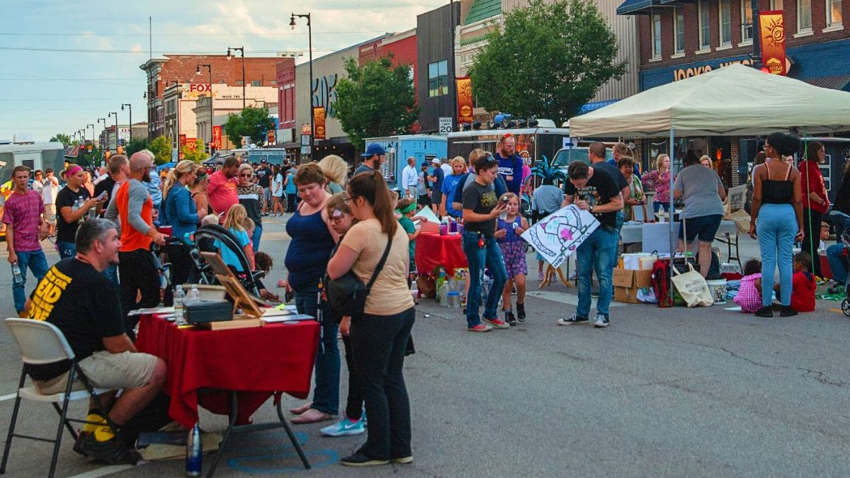
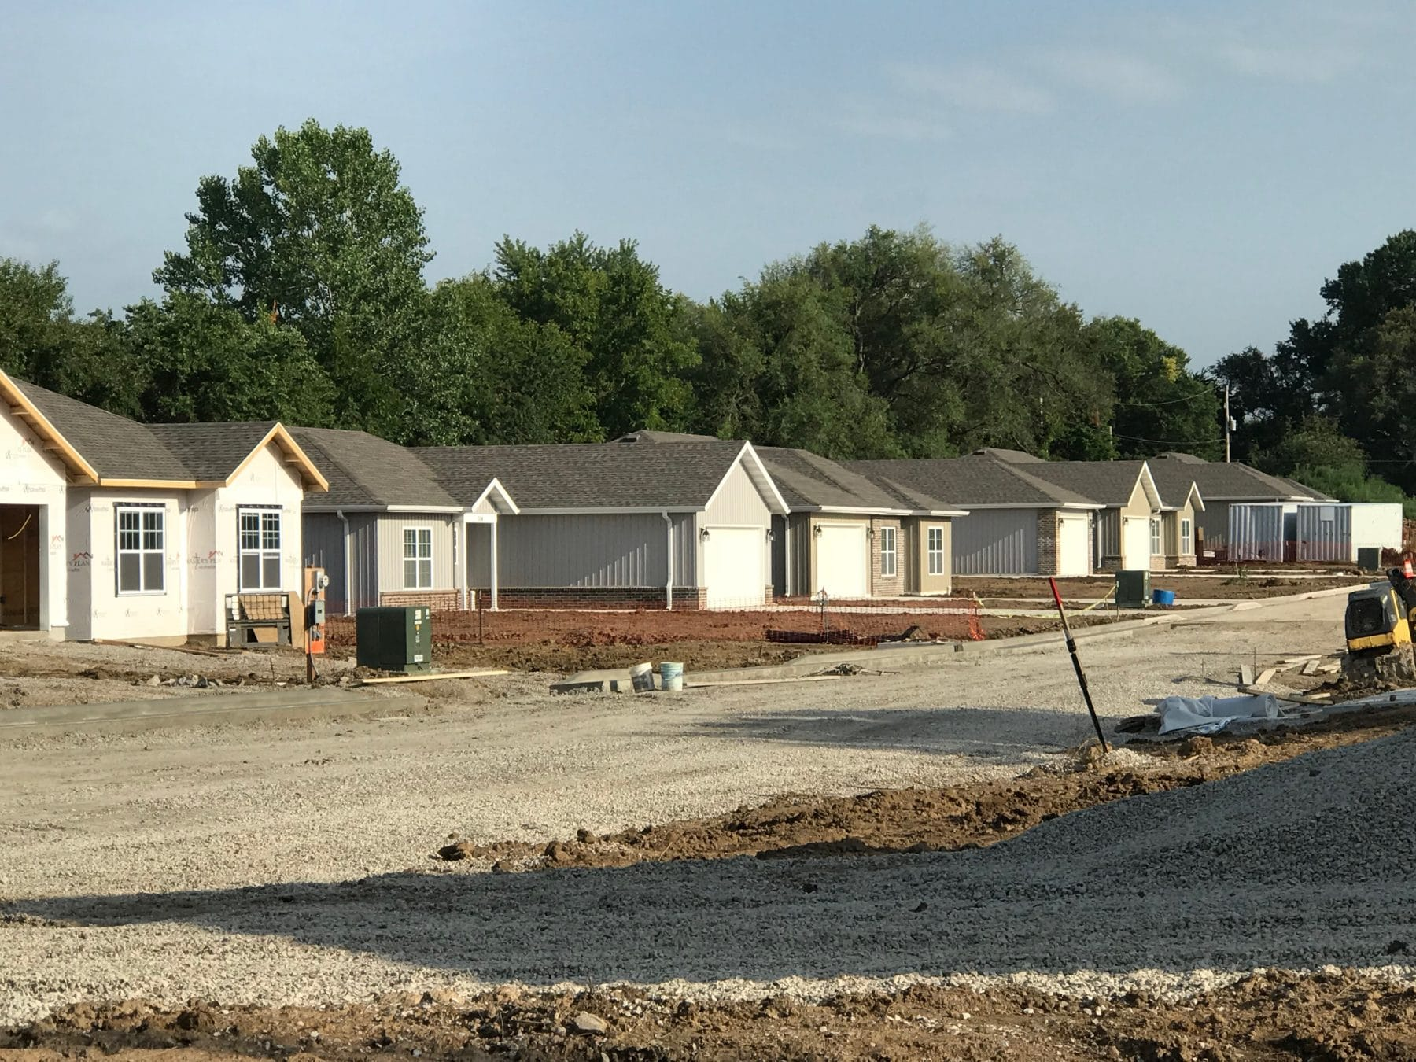
Population and Housing
2022

Slide 13
Source: Bureau of the Census and Unacast Corp.– Based on Cell Phone Movements

Slide 14
Active Housing Developments
or Recently Completed
All Phases of Construction
102 N. Locust Apartments: 10+ apartments
Block22: 99 student micro-lofts downtown
Creek East: 120 single family homes
Lakewood Drive Addition: 5 single family homes
Land Bank Lots: 40 single family homes
Leland Lofts: 6 moderate-income apartments
Payton’s Hamlet: 4 single family homes
Pitt Highlands: 25 single family homes
Silverback Landing: 140 single family homes in gated housing addition
Smith Cline Apartments: 20 apartments
Villas at Creekside: high end 55+ gated community with 29-125 units
Source : City Of Pittsburg

Slide 15
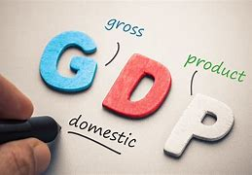

Local GDP and Household Income

Slide 17
Source: Demographics Now

Slide 18
Source: Equifax

Slide 21
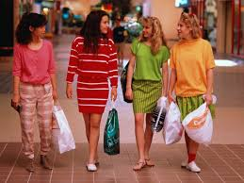
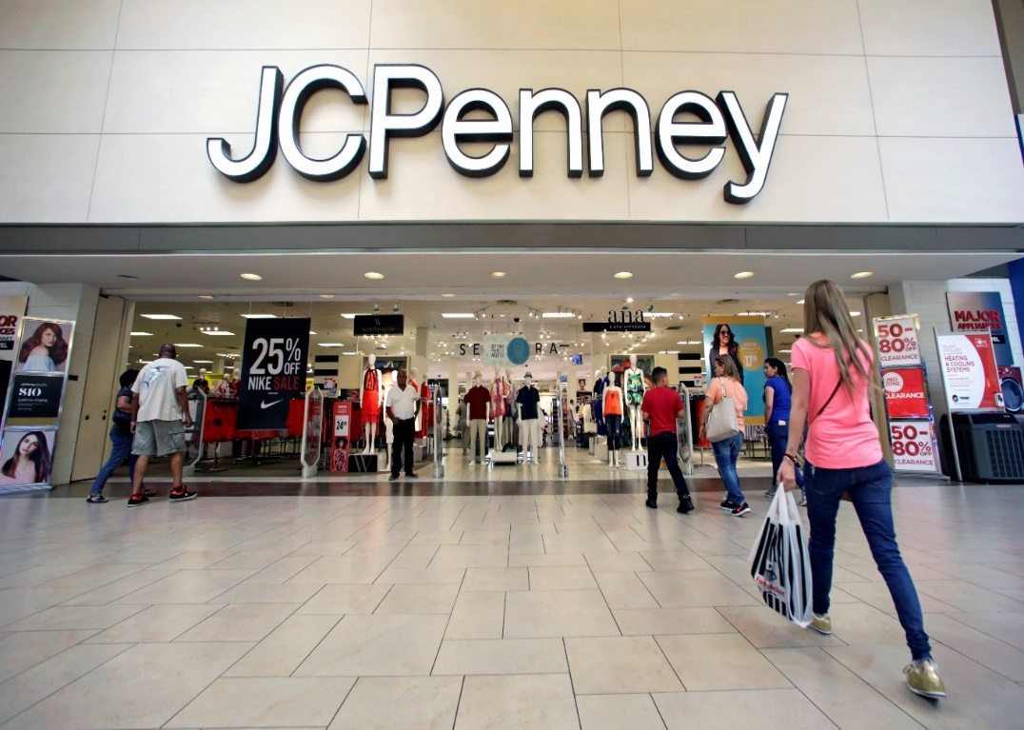
Taxable Sales (Retail Sales and Some Services, Mostly on Tourism)

Slide 22
Source: Kansas Department of Revenue

Slide 23
Source: Kansas Department of Revenue

Slide 24
Source: Kansas Department of Revenue

Slide 25
Source: Kansas Department of Revenue

Slide 26

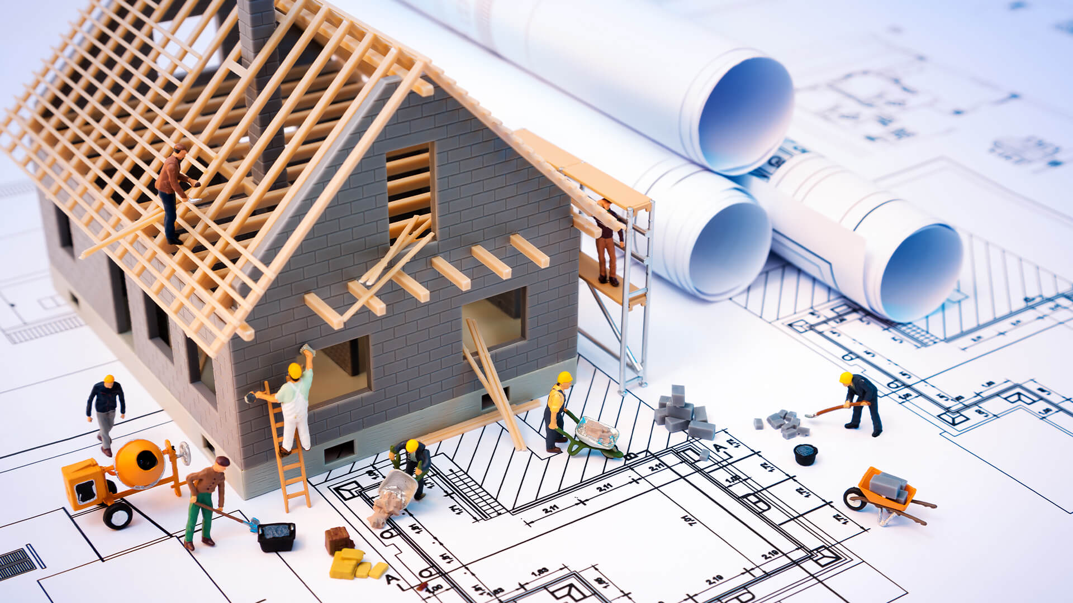
Local Financial Resources, Economic Development and Construction

Slide 27
Source: FDIC

Slide 28
Source: City of Pittsburg

Slide 29
Source: Jones Heritage Realtors
* Based on Sales

Slide 30
Source: City of Pittsburg

Slide 31
Source: Kansas City Regional Association of Realtors & Heartland MLS

Slide 32
Source: Kansas City Regional Association of Realtors & Heartland MLS

Slide 33
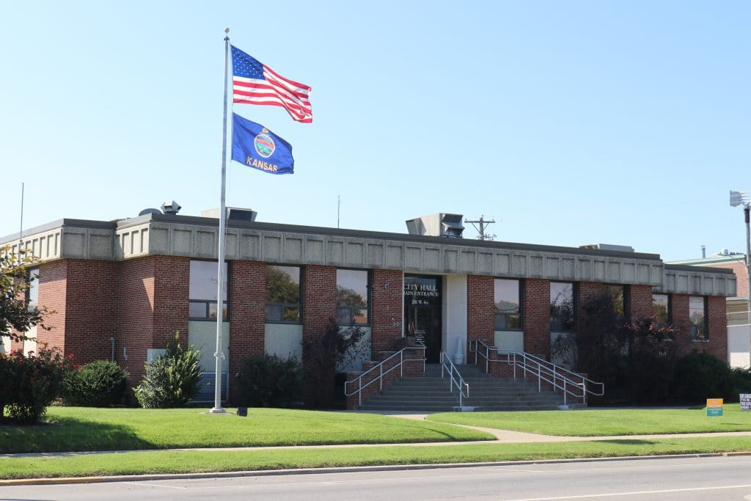
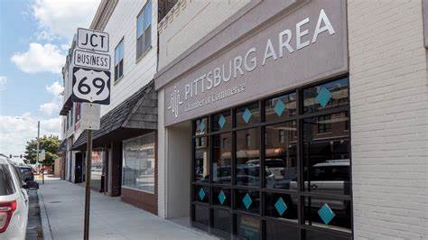
Recent Local Improvements in Quality of Live And Economic Growth

Slide 34
Economic Growth and Quality of Life in Pittsburg is Getting Noticed Nationwide
In 2019 U.S. News and World Report ranked the Pittsburg Area significantly higher than 813 other similar communities nationwide classified as 'urban, up-and-coming
36.1 percent greater access to local hospital beds per capita
15.4 percent lower violent crime per capita
32.1 percent lower homicide rate per capita
85.3 percent better access to food outlets per capita
105.8 percent better access to childcare facilities per capita
17.3 percent greater jobs diversity per capita
In 2020, PCMag ranked Pittsburg as the 31st best city nationwide in which to work from home
In 2020, the Wichita Business Journal ranked the MBA at Pittsburg State University as the best statewide
In 2020, Smart Asset ranked Pittsburg 9th best to live nationwide for seniors who have over $1 million
In 2021, Business View Magazine called Pittsburg a diamond in the rough
In 2021, Unacast reported that Pittsburg was the 4th fastest growing small city nationwide

Slide 35
Thank you
Dr. Michael Davidsson

